Slide 1
Decidability vs Undecidability
CHAPTER- 9 (PART 1)

Slide 2
Decidability and Undecidability
Recursive Language:
A language ‘L’ is said to be recursive if there exists a TM which will accept all the strings in ‘L’ and rejects all the strings not in ‘L’.
The TM will halt every time and give an answer (accepted or rejected) for each and every string input.
Recursively Enumerable Language:
A language ‘L’ is said to be a recursively enumerable language if there exists a TM which will accept (and therefore halt) for all the input strings which are in ‘L’.
But may or may not halt for all input strings which are not in ‘L’.

Slide 3
Contd…
Decidable Language:
A language ‘L’ is decidable if it is a recursive language.
All decidable languages are recursive languages and vice-versa.
Partially Decidable Language:
A language ‘L’ is partially decidable if ‘L’ is a recursively enumerable language.
Undecidable Language:
A language is undecidable if it is not decidable.
An undecidable language may sometimes be partially decidable but not decidable.
If a language is not even partially decidable, then there exists no TM for that language.

Slide 4
Contd…
Language | Description
Recursive Language | TM will always halt
Recursively Enumerable Language | TM will halt sometimes and may not halt sometime
Decidable Language | Recursive Language
Partially Decidable Language | Recursively Enumerable Language
Undecidable | No TM for that langauge

Slide 5
Universal Turing Machine
The Language:
A_{TM}={<M,w> | M is a Turing Machine and M accepts w} is Turing Recognizable.
Given the description of a TM and some input, can we determine whether the machine accepts it?
Just simulate/Run the TM on the input
M Accepts w: Our algorithm will Halt & Accept
M Rejects w: Out algorithm will Halt & Reject
M Loops on w: Our algorithm will not Halt

Slide 6
Contd…
Input:
M= the description of some TM
w= an input strings for M
Action:
Simulate M
Behave just like M would (may accept, reject or loop)
The UTM is a recognizer (but not a decider) for
A_{TM}={<M,w> | M is a Turing Machine and M accepts w}

Slide 7
The Halting Problem
Given a Program, will it HALT?
Given a TM, will it halt when run on some particular given input string?
Give some program written in some language (Java/C, etc.) will it ever get into an infinite loop or will it always terminate?
Answer:
In general, we can not always know.
The best we can do is to run the program and see whether it halts.
For many programs we can see that it will always halt or sometimes loop
But for programs in general the question is undecidable.

Slide 8
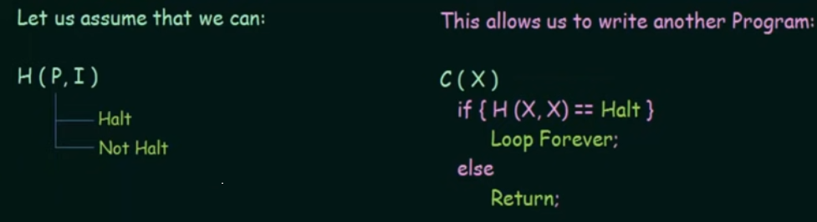
Undecidability- The Halting Problem
Given a program, will it Halt?
Can we design a machine which if given a program can find out or decide if that program will always halt or not halt on a particular input?

Slide 9
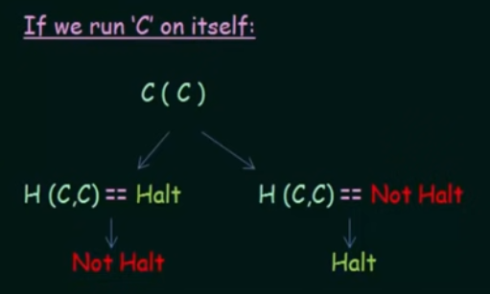
Contd…

Slide 10
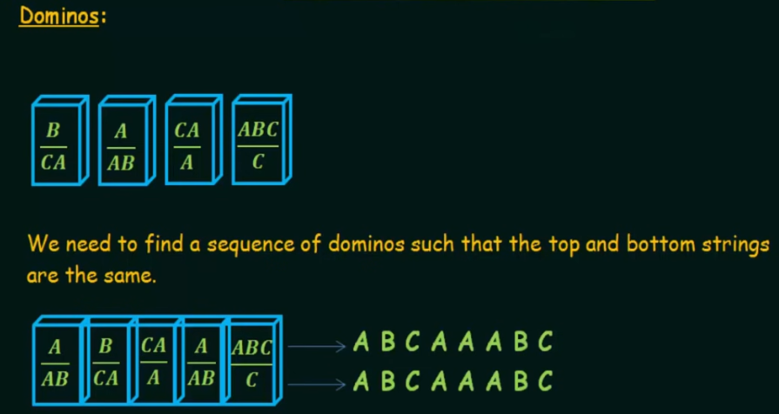
The Post Correspondence Problem (PCP)
The PCP is an undecidable decision problem that was introduced by Emil Post in 1946.

Slide 11
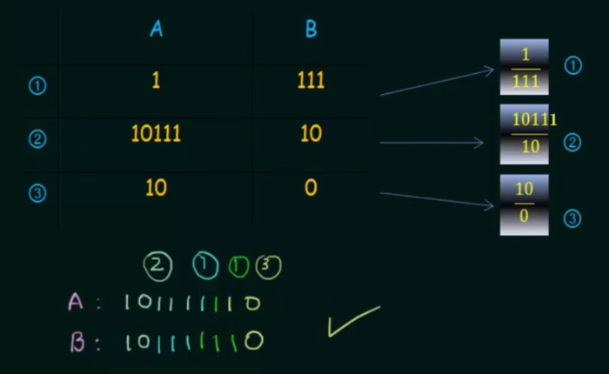
Example

Slide 12
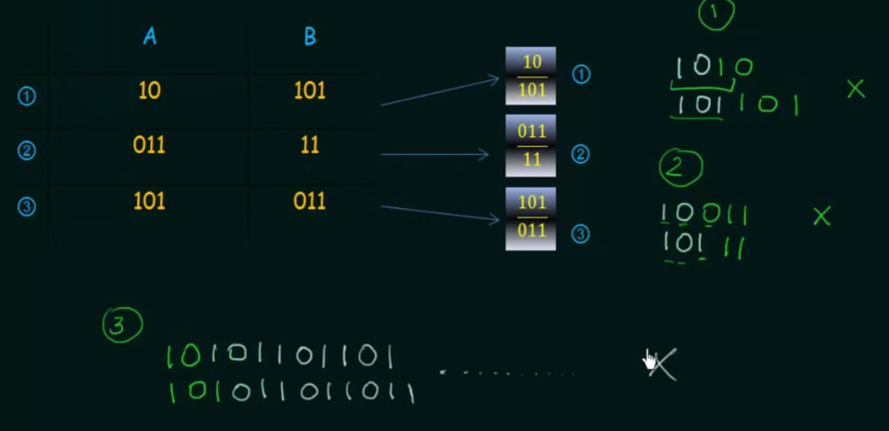
Example 2

Slide 13
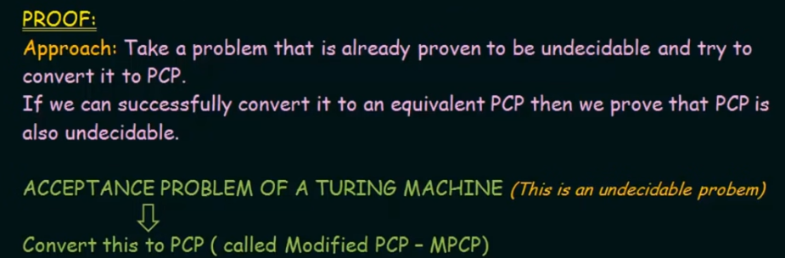
Undecidability- The PCP

